Slide 1
Discrete Mathematics
South China University of Technology
1

Slide 2
Chapter 7. Relations
Partial Orderings
Section 7.6
2

Slide 3
Contents
1
Introduction
2
Lexicographic Order
3
Hasse Diagrams
4
Maximal and Minimal Elements
5
Lattices and Topological Sorting
3

Slide 4
Introduction
4

Slide 5
Definition 1
A relation R on a set S is called a partial ordering or partial order, denoted by (S,R) or (S, ⪯), if it is
reflexive,
antisymmetric, (与等价的唯一区别)
and transitive.
Note: (a,b) ∈ R ⇔ a ⪯ b

Slide 6
Examples
1、 R={(a,b)| course b requires priori knowledge of course a }.
Thus : discrete math ⪯ database
2、 R={(a,b)| if a ≠ b, then a is the mother or father of b}.
Thus : 王健林⪯ 王思聪
Note: (a,b) ∈ R ⇔ a ⪯ b

Slide 7
Examples
1、“greater than or equal” relation (≥) is partial ordering on the set of integer.
2、“divisibility relation” ( | ) is a partial ordering on the set of positive integer.
3、”inclusion relation” ( ⊆ ) is a partial ordering on the power set of a set S.

Slide 8
Definition 2
Definition. (S, ⪯) is a poset. a,b ∈ S are comparable, if (a ⪯ b) ∨ (b ⪯ a). In other words, if ((a,b) ∈R )∨( (b,a) ∈R ).
In poset (Z+, | ) are the integers 3 and 9 comparable?

Slide 9
Definition 2
Definition . When neither a ⪯ b nor b ⪯ a, a, b are called incomparable. In other words, if ((a,b) ∉ R ) ∧( (b,a) ∉R ).
In poset (Z+, | ) are 5 and 7 comparable?

Slide 10
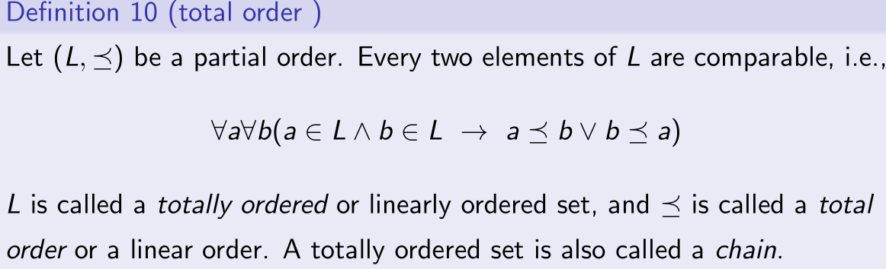
Definition 3
(Z,≤) is totally ordered, but (Z+, | ) is not.

Slide 11
Lexicographic
Order
11

Slide 12
The lexicographic ordering
(a1, a2) < (b1, b2) is defined as
Either if a1 < b1
or if both a1 = b1 and a2 < b2
(3,5) < (4,8) (3,8) < (4,5) (4,9) < (4,11)
(1,2,3,5) < (1,2,4,3)
discreet < discrete
discreet < discreetness

Slide 13
Lexicographic Order
(1,7) (2,7) (3,7) (4,7) (5,7) (6,7) (7,7)
(1,6) (2,6) (3,6) (4,6) (5,6) (6,6) (7,6)
(1,5) (2,5) (3,5) (4,5) (5,5) (6,5) (7,5)
(1,4) (2,4) (3,4) (4,4) (5,4) (6,4) (7,4)
(1,3) (2,3) (3,3) (4,3) (5,3) (6,3) (7,3)
(1,2) (2,2) (3,2) (4,2) (5,2) (6,2) (7,2)
(1,1) (2,1) (3,1) (4,1) (5,1) (6,1) (7,1)

Slide 14
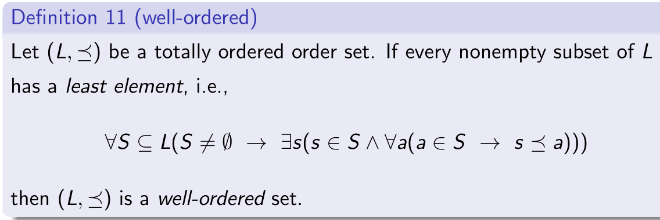
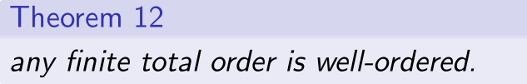

well ordered.
(${\text{Z}}^{+}$, ≤ ) is well ordered.
(Z, ≤ ) is not well ordered.
(${\text{Z}}^{+}$ $×$ ${\text{Z}}^{+}$, ≤ ) is well ordered too.

Slide 15
Hasse Diagrams
15

Slide 16
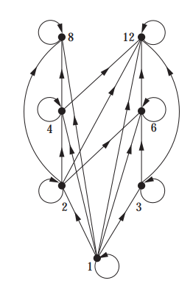
Diagrams
Represent ({1,2,3,4,6,8,12}, |) by a Diagram:

Slide 17
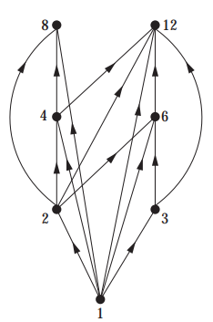
Diagrams to Hasse Diagrams
1. remove loops.

Slide 18
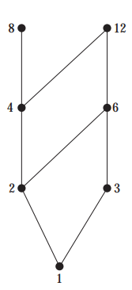
Diagrams to Hasse Diagrams
2. if (a,b) and (b,c) are in the partial ordering, remove (a,c). if (c,d) is also in the partial ordering, remove the edge (a,d).

Slide 19
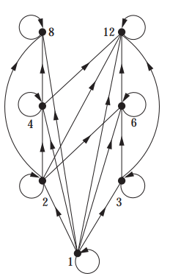
Diagrams to Hasse Diagrams
3 Arrange each edge so that its initial vertex is below its terminal vertex.
4 Remove all the arrows on the directed edges.

Slide 20
Examples
The partial ordering { (A,B)| A ⊆ B } on the power set P(S) where S={ a,b,c }
(Ø,{a,b}) (Ø,{a,c})
(Ø,{b,c}) (Ø,{a,b,c})
({a},{a,b,c}) ({b},{a,b,c})
({c},{a,b,c})………

Slide 21
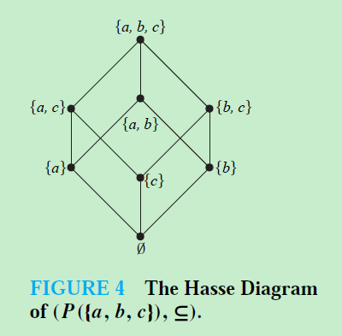

Slide 22
Maximal and Minimal Elements
22

Slide 23
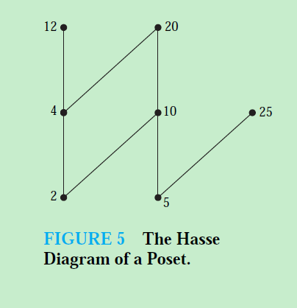
Maximal and Minimal
a is maximal 极大元 in the poset (S,⪯) if there is no b ∈ S such that a  b.

Slide 24
Maximal and Minimal
a is minimal极小元of there is no element b ∈ S such that b  a.

Slide 25
Maximal and Minimal
They are the “top” and “bottom” elements in the diagram.

Slide 26
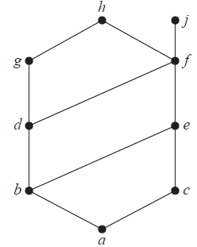

least element
$a$ is the least element of $(S,≤)$ if
The least element is unique when it exists.

Slide 27
least element
Example. What is the greatest and least element in the poset (P(S), ⊆) ?
S and Ø.
Example. Is there a greatest element and a least element in the poset (Z+,|)?
no one and 1.

Slide 28
Upper bound and Lower bound
(S,≤) is a poset. A ⊆ S. u∈S. u is called an upper bound of A, If
note: it may be

Slide 29
Example Upper bound
The upper bounds of { a,b,c } are ?
e, f, j and h.
There is no upper bounds of { j, h } ?
Y
The upper bounds of { a,c,d,f } are?
f, h, and j.

Slide 30
Upper bound and Lower bound
If l is an element of S such that l ≤ a for all elements a ∈ A, then l is called as an lower bound of A.

Slide 31
Example Lower bound
The lower bound of { a,b,c } is ?
a.
The lower bounds of { j, h } are?
a,b,c, d, e and f.
The lower bounds of { a,c,d,f } is ?
a.

Slide 32
least upper bound
The element x is called the least upper bound (lub) of the subset A if
x is an upper bound of A.
Following 2nd requirement, if lub exist, then it is unique.

Slide 33
Example 18
The least upper bounds of { b,d,g } are ?
g.
The greatest lower bounds of { b,d,g } are ?
b.
j
h
g
f
d
e
b
c
a

Slide 34
greatest lower bound
The element y is called the greatest lower bound (glb) of A if y is a lower bound of A and z ≤ y whenever is a lower bound of A.

Slide 35
Example 18
The least upper bounds of { b,d,g } are ?
g.
The greatest lower bounds of { b,d,g } are ?
b.
j
h
g
f
d
e
b
c
a

Slide 36
Topological Sorting
36

Slide 37
Topological Sorting
A total ordering W is said to be compatible with partial ordering R if
Constructing a compatible total ordering W from a partial ordering R is called topological sorting.
本质是: 输入一个部分有序R, 构造一个全部有序W.

Slide 38
Lemma 1
Every finite nonempty poset (S, ≤) has a minimal element 极小元.
Proof can be found directedly.
Therefore, every finite nonempty poset can be sorted “topologically” by an algorithm.

Slide 39
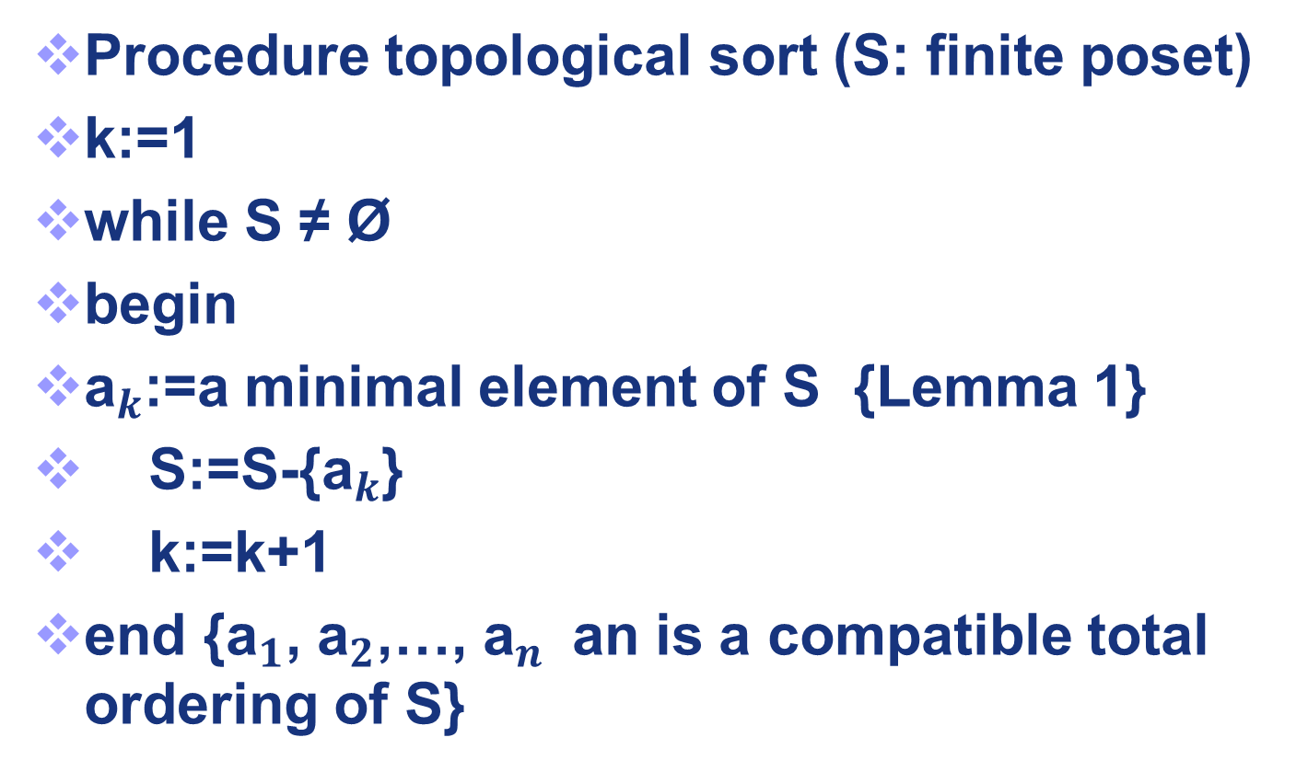
Algorithm: Topological Sorting
Procedure topological sort (S: finite poset)
k:=1
while S ≠ Ø
begin
${\text{a}}_{k}$:=a minimal element of S {Lemma 1}
S:=S-{${\text{a}}_{k}$}
k:=k+1
end {${\text{a}}_{1}$, ${\text{a}}_{2}$,…, ${\text{a}}_{n }$an is a compatible total ordering of S}

Slide 40
Example 25
Find a compatible total ordering for the poset ({1,2,4,5,12,20},|)
12
20
12
20
12
20
12
20
12
20
12
4
4
4
4
2
5
2
5
2
1
1
< 5
< 2
< 4
< 20
< 12

Slide 41
Example 26
Find topological sort of the task.
G
G
G
G
G
G
G
D
F
D
F
D
F
D
F
D
F
D
B
B
B
A
C
E
C
E
E
E
A
< C
< B
< E
< F
< D
< G

Slide 42
Lattices
42

Slide 43
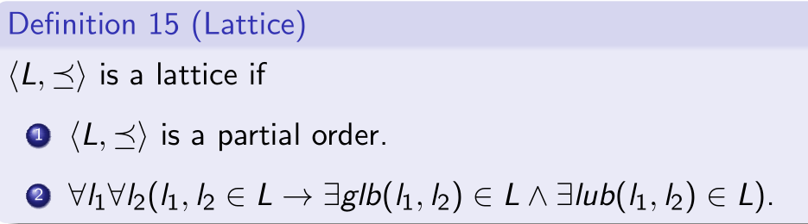
Lattices
Note: glb, lub are unique
The poset { Z+, | } is a lattice.
(P(S), ⊆) is a lattice where S is a Set.
({ 1,2,3,4,5 }, |) is not a lattice.
({ 1,2,4,8,16 }, |) is a lattice.

Slide 44
Example 20
Lattices.
Because in the poset every pair of elements has both a least upper bound and a greatest lower bound.
f
e
c
d
b
a

Slide 45
Example 20
Not a lattices.
Because elements b and c have no least upper bound.
f
d
e
b
c
a

Slide 46
Example 20
Lattices.
Because in the poset every pair of elements has both a least upper bound and a greatest lower bound.
h
e
g
k
d
b
f
a

Slide 47
Application
Based on lattice theory, we can construct security schemes of access control.
See textbook.

Slide 48
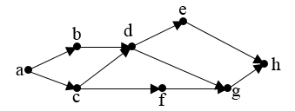
历史上的考题
A project of software development contains several tasks with the notations from “a” to “h”. The dependencies between tasks are shown in the following directed graph. Each vertex represents a task, and the initial vertex of an edge should be completed before the terminal vertex is carried out. You are asked to give an order to complete the tasks into a sequence based on their dependency relationships.

Slide 49
Homework
3 d)
4 c)
5 ,6
17
22
26

Slide 50
End of Section 7.6
Click to edit company slogan .
50

